Slide 1

Exploratory Data Analysis
ANZ Transaction Data

Slide 2

Contents
Introduction
Analysis Page 1
Analysis Page 2
Conclusion

Slide 3
Introduction
Synthesized transaction dataset
Containing 3 months worth of transactions
100 Hypothetical Customers
It contains purchases, recurring transactions, and salary transactions.

Slide 4
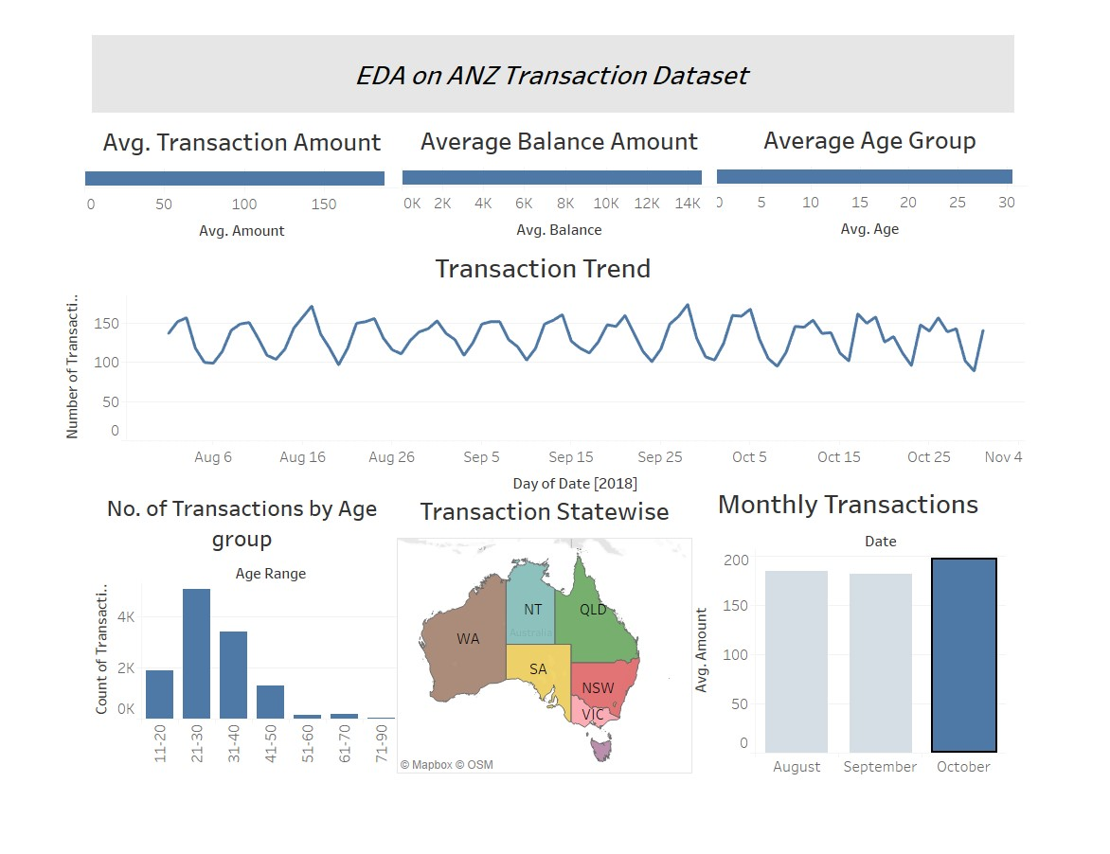
Interactive Link

Slide 5
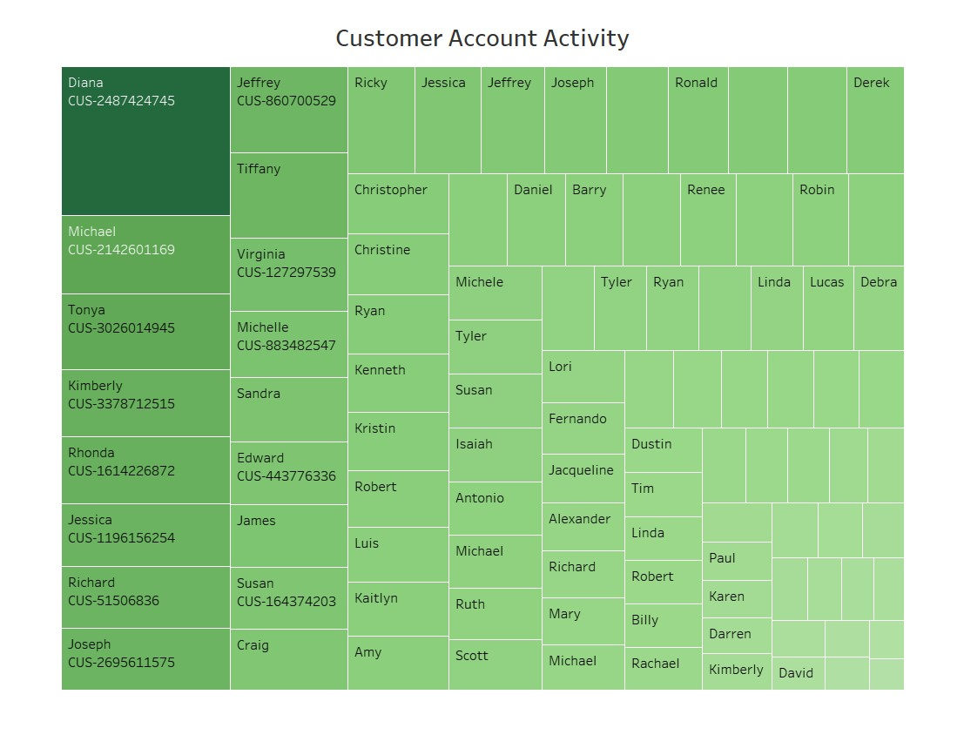
Interactive Link

Slide 6

Thank You.

